Slide 1


Michal Fornalski
2023-02-16

Slide 2

Outline
Executive Summary
Introduction
Methodology
Results
Conclusion
Appendix

Slide 3
Executive Summary
Summary of methodologies
Data collection using SpaceX API and Wikipedia Web Scraping
Data Wrangling
Exploratory Data Analysis (EDA) with SQL and Data Visualization
Interactive visual analytics with Folium maps
Plotly Dash Dashboard
Machine learning predictive analysis
Summary of all results
EDA Results
Interactive analysis
Predictive analysis

Slide 4
Introduction
Project background and context
SpaceX advertises Falcon 9 rocket launches on its website with a cost of 62 million dollars; other providers cost upward of 165 million dollars each, much of the savings is because SpaceX can reuse the first stage. Therefore if we can determine if the first stage will land, we can determine the cost of a launch. This information can be used if an alternate company wants to bid against SpaceX for a rocket launch.
Problems you want to find answers
What makes the successful launch a success.
Can we predict if the Falcon 9 first stage will land successfully based on available data.

Slide 5

Section 1

Slide 6
Methodology
Executive Summary
Data collection methodology:
The data was collected from 2 sources
SpaceX API (https://api.spacexdata.com/v4)
Web scraping (Wikipedia page)
Perform data wrangling
Basic data cleaning, One Hot encoding for landing outcome as preparation for machine learning.
Perform exploratory data analysis (EDA) using visualization and SQL
Perform interactive visual analytics using Folium and Plotly Dash
Perform predictive analysis using classification models
LR, SVM, DT & KNN methods were used to determine if the first stage of Falcon 9 will land successfully.
Best parameters, accuracy & confusion matrixes were established for each of the models.

Slide 7
Data Collection
The data was collected from 2 sources:
SpaceX API (https://api.spacexdata.com/v4)
Web scraping (Wikipedia page)
SpaceX API
Get request
Decoding & Filtering
Pandas Data Frames
Wikipedia Falcon 9 launch Page
Get request
Scraping & Extracting

Slide 8
Data Collection – SpaceX API
Request rocket launch data from SpaceX API
Decoding the response content as a Json using .json() and turning it into a Pandas dataframe using .json_normalize()
Filtering the data dataframe using the BoosterVersion column to only keep the Falcon 9 launches.
Dealing with Missing Values
Get request to the Spacex API
Decode response and turn it into Pandas Data Frame
Strip the dataset of unneeded features
Filter for 'Falcon 9' launches only
Replace the existing 'nan's with mean value of the feature
For more detailed information see the Jupyter notebook

Slide 9
Data Collection - Scraping​
HTTP GET method to request the Falcon9 Launch HTML page, as an HTTP response
Create a `BeautifulSoup` object from the HTML `response`
Extract all column/variable names from the HTML table header
Extract Column names
Create a data frame by parsing the launch HTML tables
HTTP Get request to the Falcon 9 Lanuch HTML Page on Wikipedia
Create a `BeautifulSoup` object from the HTML `response`
Extract all column/variable names from the HTML table header
Extract Column names
Create a data frame by parsing the launch HTML tables
For more detailed information see the Jupyter notebook

Slide 10
Data Wrangling
Data processing steps
Identification and calculation of the percentage of the missing values in each attribute to determine the quality of the data.
Calculation of the number of launches on each site.
Calculation of the number and occurrence of each orbit.
Calculation of the number and occurrence of mission outcome per orbit type.
One Hot encoding for landing outcome as preparation for machine learning.
Identify the missing values
Number of launches on each site
Number and occurrence of each orbit.
number and occurrence of mission outcome per orbit type
One Hot encoding for landing outcome
For more detailed information see the Jupyter notebook

Slide 11
EDA with Data Visualization
Charts used
Scatter point chart visualizing the relationship between Flight Number and Payload
Scatter point chart visualizing the relationship between Flight Number and Launch Site
Scatter point chart visualizing the relationship between Payload and Launch Site
Bar chart visualizing the Success rate of each orbit type.
Scatter point chart visualizing the relationship between Orbit and Flight Number
Scatter point chart visualizing the relationship between Payload and Orbit Type
Line chart visualizing launch success yearly trend
For more detailed information see the Jupyter notebook

Slide 12
EDA with SQL
SQL queries performed
%sql select Unique(LAUNCH_SITE) From SPACEX
%sql select * From SPACEX Where LAUNCH_SITE Like 'CCA%' limit 5
%sql select Sum(payload_mass__kg_) From SPACEX Where Customer = 'NASA (CRS)'
%sql select AVG(payload_mass__kg_) From SPACEX Where booster_version like 'F9 v1.1%'
%sql select min(Date) From SPACEX Where landing__outcome = 'Success (ground pad)'
%sql select booster_version From SPACEX Where landing__outcome = 'Success (drone ship)' and payload_mass__kg_ between 4000 and 6000
%sql select mission_outcome, count(mission_outcome) AS Count From SPACEX Group By mission_outcome
%sql Select booster_version From SPACEX Where payload_mass__kg_ = (Select max(payload_mass__kg_) From SPACEX)
%sql Select booster_version, launch_site From SPACEX Where landing__outcome = 'Failure (drone ship)' and year(DATE) = '2015'
%sql select landing__outcome, count(landing__outcome) as COUNT from SPACEX Where DATE between '2010-06-04' and '2017-03-20' group by landing__outcome order by count(landing__outcome) DESC
For more detailed information see the Jupyter notebook

Slide 13
Build an Interactive Map with Folium
Different objects such as: markers, circles and lines were added to the maps with explicit purpose:
Markers type 1 - added to indicate different Launch Sites
Markers type 2 – added to indicate all launches locations
Circles - added to indicate different Launch Sites
Lines – added to indicate distance from Launch site to: coast line, closest highway, closest railway & closest city.
For more detailed information see the Jupyter notebook

Slide 14
Build a Dashboard with Plotly Dash
Using the skeleton app provided by the course as a base there were few modification that were made:
Adding a Launch Site Drop-down Input Component
Adding a callback function to render success-pie-chart based on selected site dropdown
Adding a Range Slider to Select Payload
Adding a callback function to render the success-payload-scatter-chart scatter plot
Charts:
Pie chart of the total successful launches by site
Scatter plot showing correlation between Payload and success for all sites
For more detailed information see the Jupyter notebook

Slide 15
Predictive Analysis (Classification)
Summary of the predictive analysis steps
Creation of a Numpy Array from the 'Class' Column in the dataset
Data standardization using Standard Scaler from scikit-learn
Split data into training and testing sets (test_size=0.2, random_state=2)
Create, Fit & Find the hyperparameters for each of the models (LR, SVM, DT & KNN)
Plot Confusion Matrixes for each model
Compare model accuracy
For more detailed information see the Jupyter notebook

Slide 16
Predictive Analysis (Classification)
Load the 2 datasets: dataset_part_2
dataset_part_3
Numpy Array from the 'Class' Column in the dataset_part_2
Standardization of the data in dataset_part_3
using Standard Scaler from scikit-learn
Split data into training and testing sets
Plot Confusion Matrixes for each model
Determine Hyperparameters and accuracy
Fit the objects to the training sets
Create LR, SVM, DT & KNN objects
Compare model accuracy to determine the best performing one
For more detailed information see the Jupyter notebook

Slide 17
Results
Exploratory data analysis results:
4 different launch sites were used for all the launches in the dataset
Total payload mass carried by boosters launched by NASA (CRS) = 45 596 kg
Average payload mass carried by booster version F9 v1.1 = 2 928 kg
First successful landing outcome on the ground pad was achieved on 2015-12-22
Boosters which have successfully landed on a drone ship and have payload mass greater than 4000 but less than 6000: F9 FT B1022, F9 FT B1026, F9 FT B1021.2, F9 FT B1031.2
Total number of successful and failure mission outcomes: Failure (in flight) - 1, Success – 99, Success (payload status unclear) - 1
Names of the booster_versions which have carried the maximum payload mass: F9 B5 B1048.4, F9 B5 B1049.4, F9 B5 B1051.3, F9 B5 B1056.4, F9 B5 B1048.5, F9 B5 B1051.4, F9 B5 B1049.5, F9 B5 B1060.2, F9 B5 B1058.3, F9 B5 B1051.6, F9 B5 B1060.3, F9 B5 B1049.7

Slide 18
Results
Exploratory data analysis results cont.:
Failed landing outcomes on the drone ship, their booster versions, and launch site names for year 2015: F9 v1.1 B1012 - CCAFS LC-40, F9 v1.1 B1015-CCAFS LC-40
Landing outcomes (such as Failure (drone ship) or Success (ground pad)) between the date 2010-06-04 and 2017-03-20, in descending order:
Landing outcome | COUNT
No attempt | 10
Failure (drone ship) | 5
Success (drone ship) | 5
Controlled (ocean) | 3
Success (ground pad) | 3
Failure (parachute) | 2
Uncontrolled (ocean) | 2
Precluded (drone ship) | 1

Slide 19
Results
Interactive analytics demo in screenshots
Displayed and explained in the Section 2 of the presentation
Predictive analysis results
Displayed and explained in the Section 5 of the presentation

Slide 20

Section 2

Slide 21
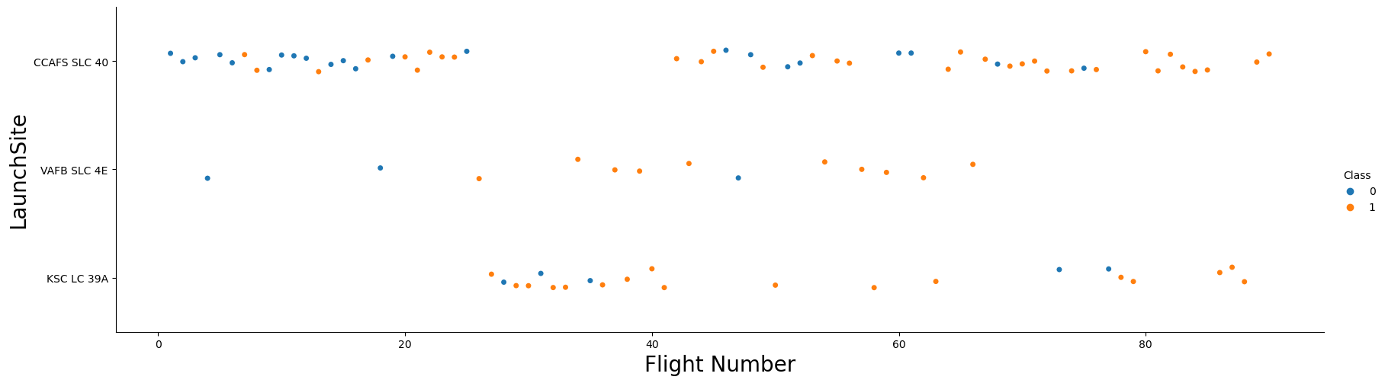
Flight Number vs. Launch Site
General success rate improved over time
Most Launches took place at CCAFS SLC 40

Slide 22
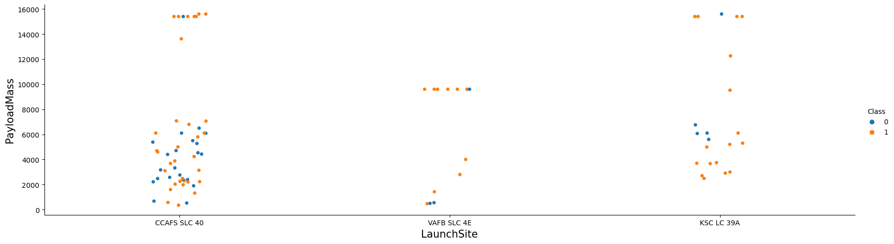
Payload vs. Launch Site
For the VAFB-SLC launch site there are no rockets launched for payload mass greater than 10000

Slide 23
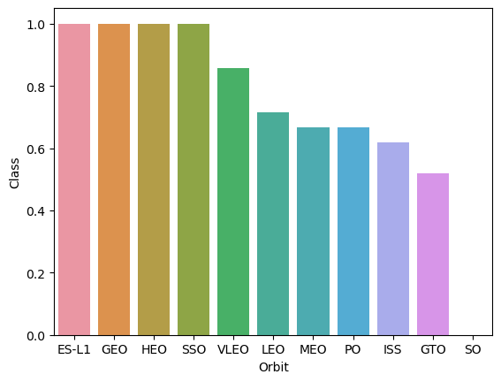
Success Rate vs. Orbit Type
ES-L1, GEO, HEO & SSO are the most successful orbit types launches.
SO, GTO & ISS have the lowest success rate of all orbit types launches.

Slide 24
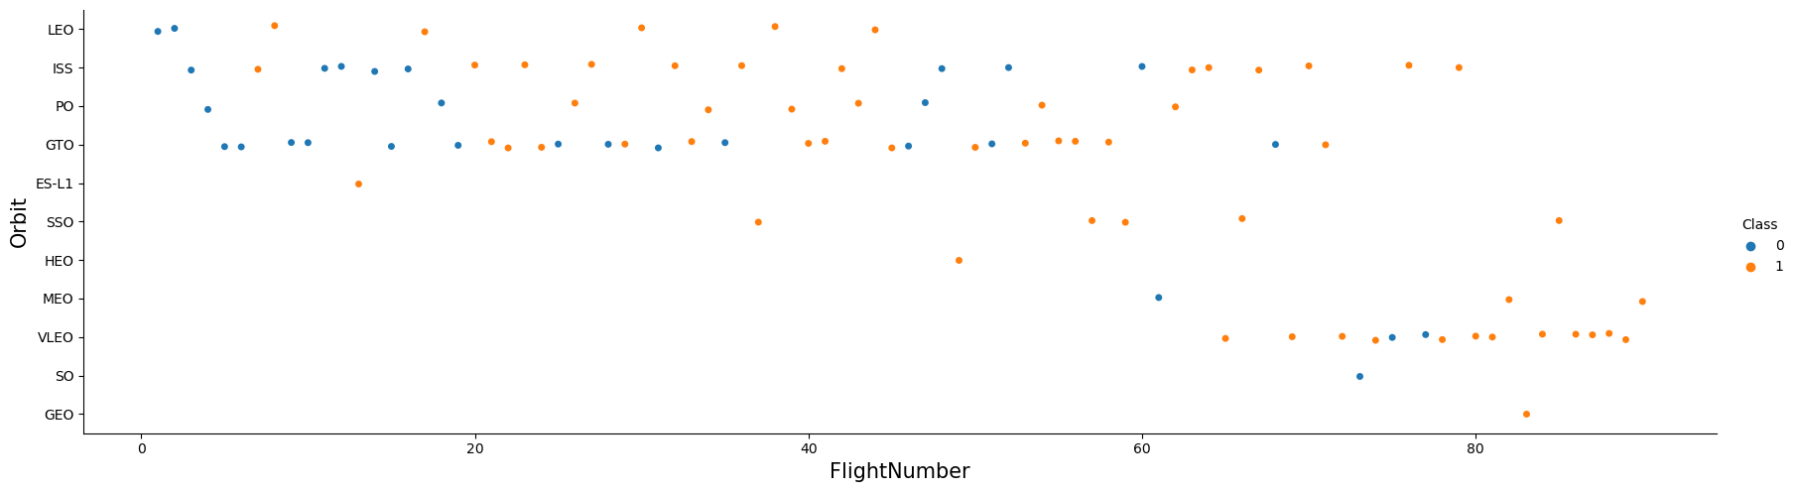
Flight Number vs. Orbit Type
LEO orbit the Success appears related to the number of flights; on the other hand, there seems to be no relationship between flight number when in GTO orbit.

Slide 25
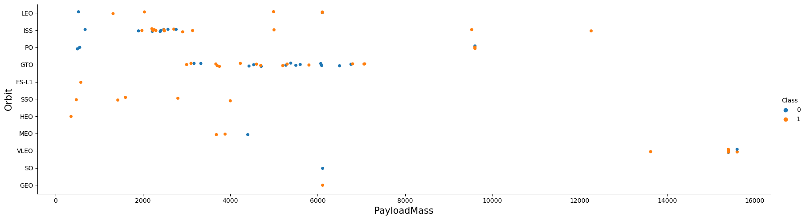
Payload vs. Orbit Type
Only a small number of launches exceed Payload Mass of 8000.
There are only few launches for orbits SO and GEO.
Orbit ISS has the widest range of payload mass.

Slide 26
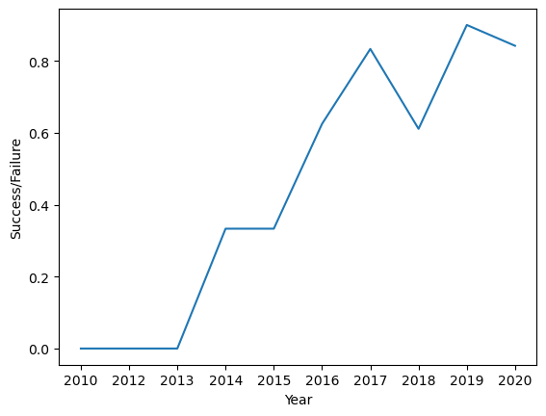
Launch Success Yearly Trend
Sucess rate since 2013 kept increasing till 2020.

Slide 27
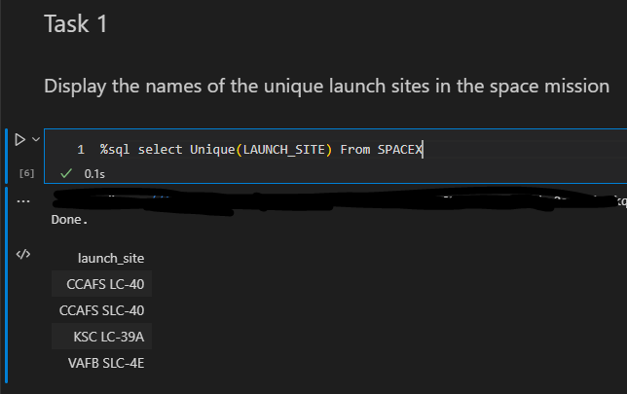
All Launch Site Names
There are 4 unique launch sites.

Slide 28
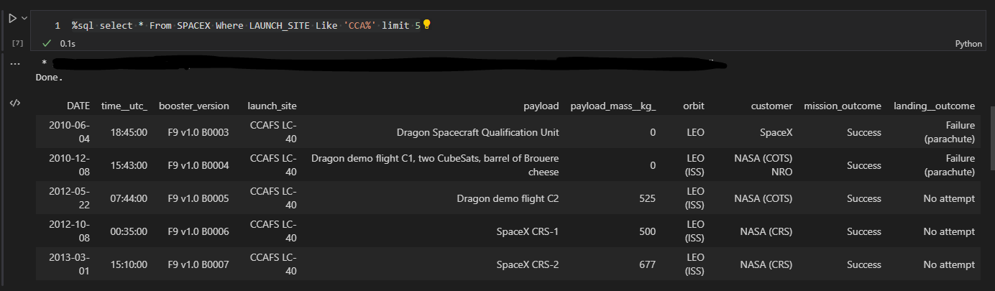
Launch Site Names Begin with 'CCA'
5 records where launch sites begin with `CCA`

Slide 29
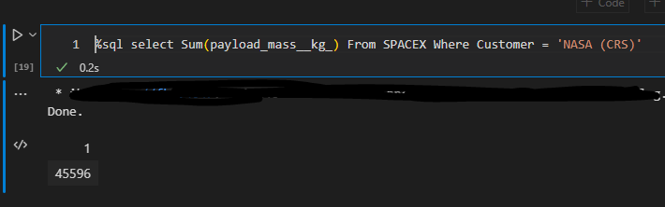
Total Payload Mass
Total payload carried by boosters from NASA = 45 596 kg

Slide 30
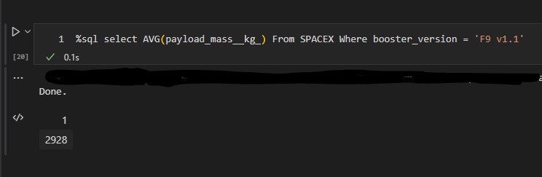
Average Payload Mass by F9 v1.1
Average payload mass carried by booster version F9 v1.1 = 2 928 kg

Slide 31
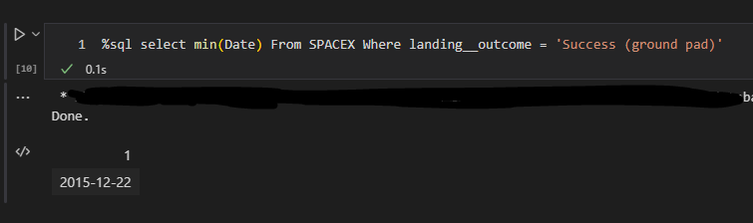
First Successful Ground Landing Date
First successful landing outcome on the ground pad took place on 2015-12-22

Slide 32
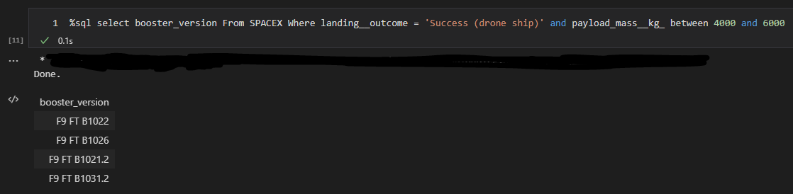
Successful Drone Ship Landing with Payload between 4000 and 6000
Boosters which have successfully landed on drone ship and had payload mass greater than 4000 but less than 6000

Slide 33
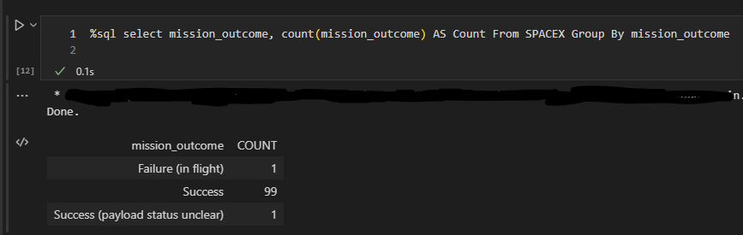
Total Number of Successful and Failure Mission Outcomes
Success: 100
Failure: 1

Slide 34
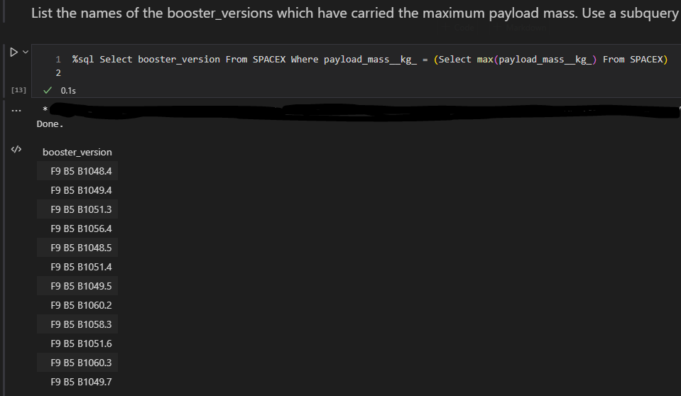
Boosters Carried Maximum Payload
12 versions of boosters have carried the maximum payload mass.

Slide 35
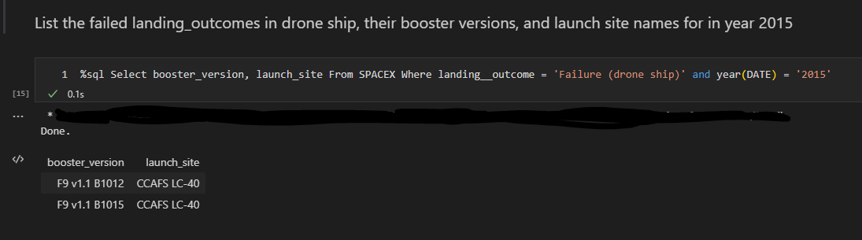
2015 Launch Records
Failed landing_outcomes on a drone ship, their booster versions, and launch site names for a year 2015
Present your query result with a short explanation here

Slide 36
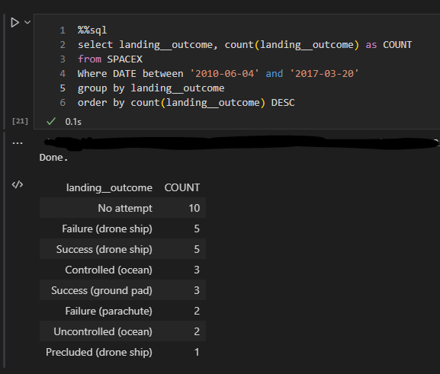
Rank Landing Outcomes Between 2010-06-04 and 2017-03-20
Number of landing outcomes (such as Failure (drone ship) or Success (ground pad)) between the date 2010-06-04 and 2017-03-20, in descending order.

Slide 37

Section 3

Slide 38
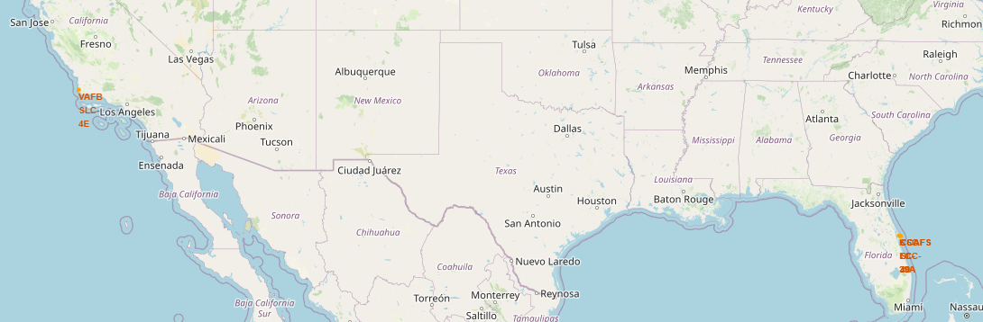
Launch sites Map

Slide 39
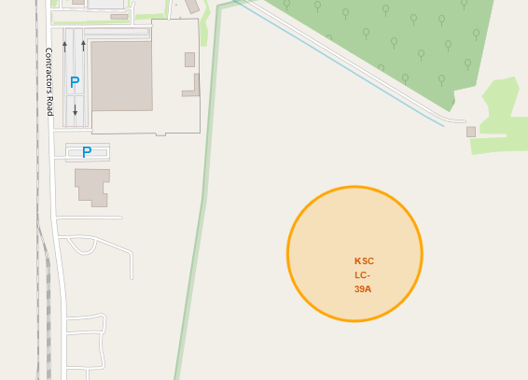
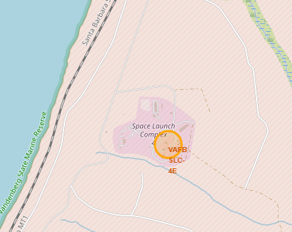
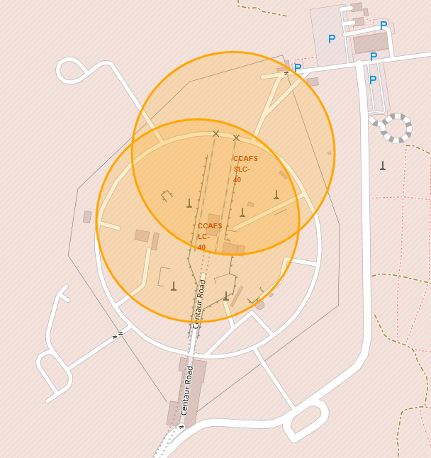
Launch sites Map
There are 4 Launch sites 3 on the East coast and 1 on the West coast
The sites are located near the sea, but also close to the key infrastructure like railroads and highways.

Slide 40
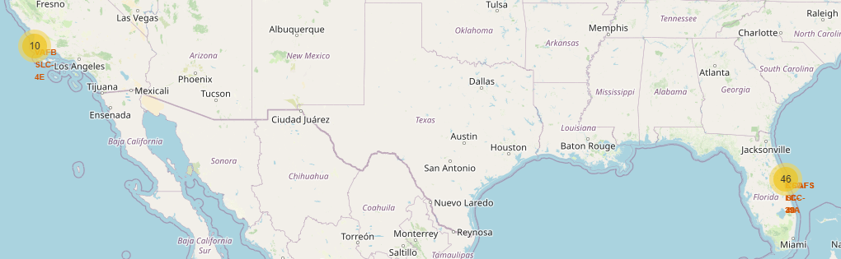
Launch outcomes map

Slide 41
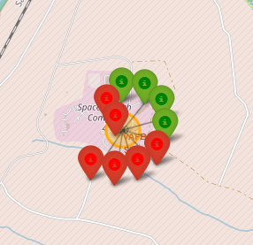
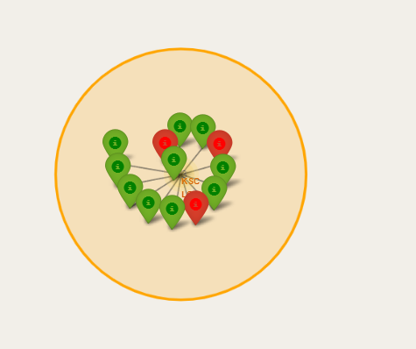
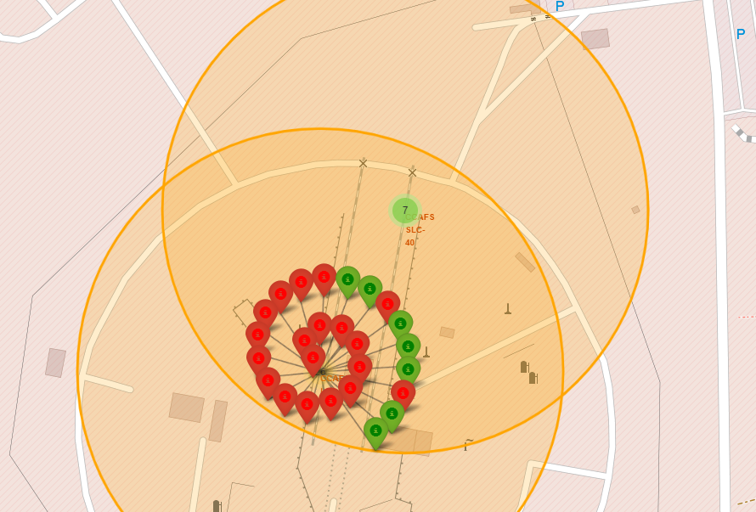
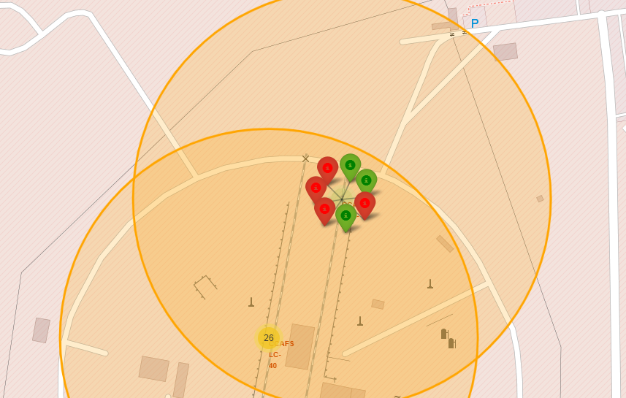
Launch outcomes map
Green markers indicate success and red ones failure.

Slide 42
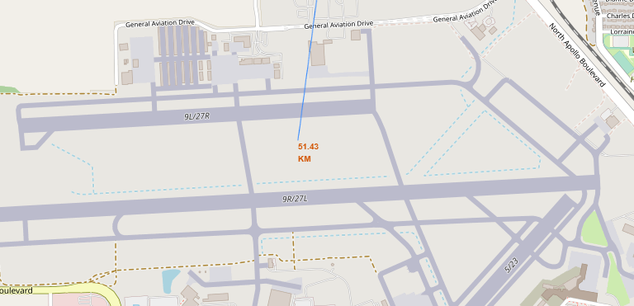
Distance to the closest City
Distance to the Closest City – 51.43 km

Slide 43
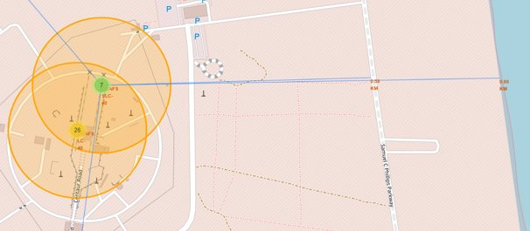
Distance to the closest highway and sea
Distance to the closest highway and sea:
Highway – 0.58 km
Sea – 0.86 km

Slide 44
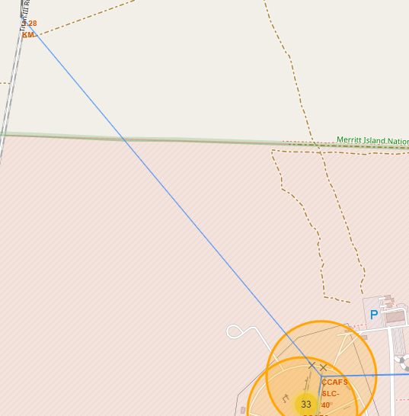
Distance to the closest rail road
Distance to the closest railroad
Rail road– 1.28 km

Slide 45

Section 4

Slide 46
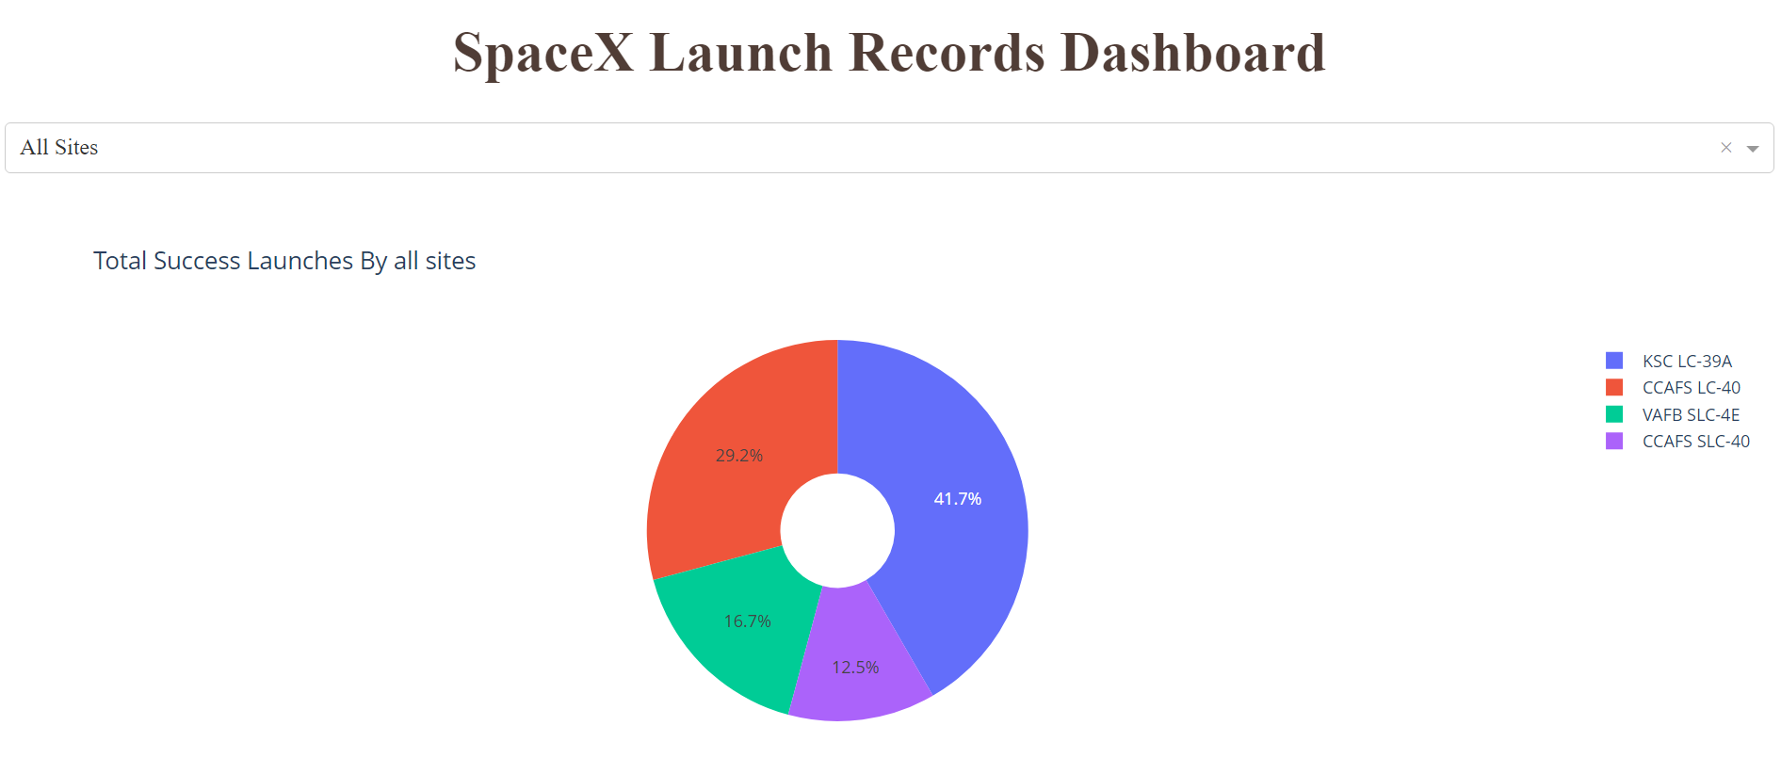
SpaceX Launch Records Dashboard
KSC LC-39A has the highest success rate of all the launch sites

Slide 47
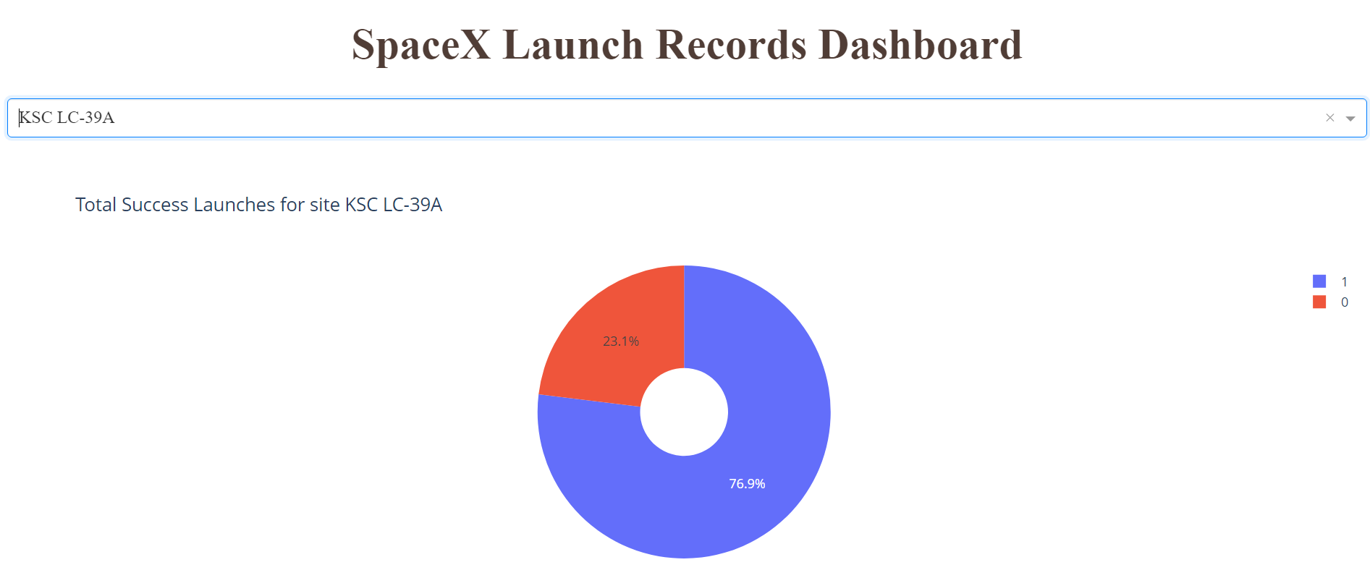
SpaceX Launch Records Dashboard
KSC LC-39A has a 76,9% launch success rate.

Slide 48
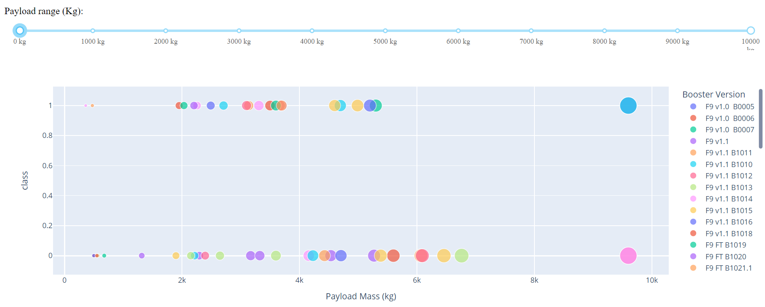
SpaceX Launch Records Dashboard
Most of the successful launches seem to be in the payload range of 2000kg to 6000kg

Slide 49
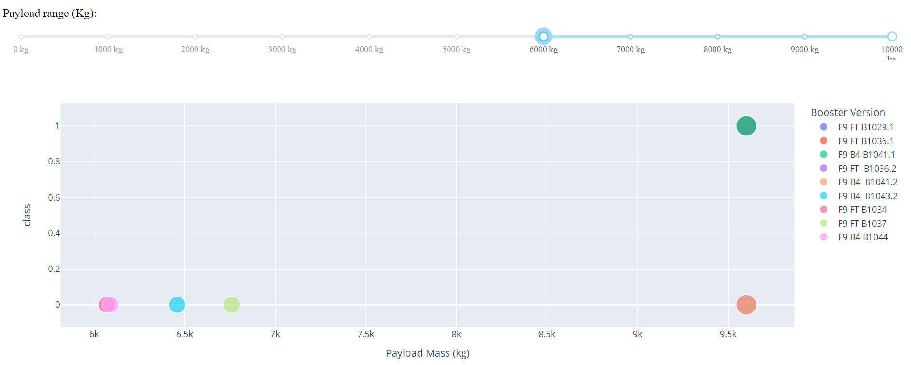
SpaceX Launch Records Dashboard
There has been only 1 successful launch in the payload range of 6000kg to 10000kg

Slide 50

Section 5

Slide 51
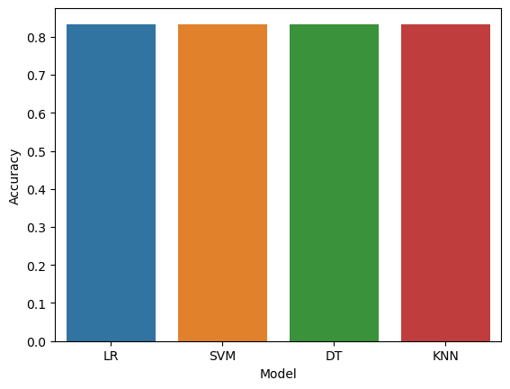
Classification Accuracy
All models have a similar accuracy of 83%

Slide 52
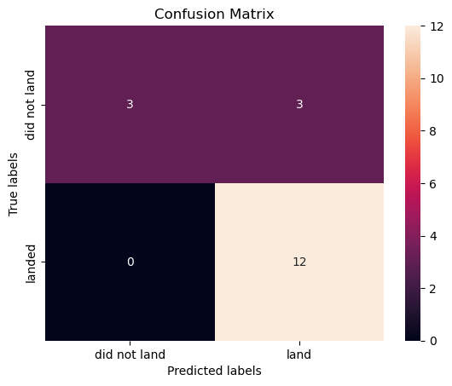
Confusion Matrix
Model's inaccuracy comes from the significant number of False Positives.

Slide 53
Conclusions
Although all models displayed similar accuracy Decision tree should hardly be trusted. It has displayed significant variations for concurrent runs which leads me to the conclusion that the model is overfitting. This is most likely caused by having too many features and to little instances.
Launch Sucess rate since 2013 kept increasing till 2020.
ES-L1, GEO, HEO & SSO are the most successful orbit types launches.
KSC LC-39A site has a 76,9% launch success rate which makes it the most successful site.
General success rate improved over time
Most Launches took place at CCAFS SLC 40

Slide 54


